Slide 1
Interprocedural Analysis
Notes:
94

Slide 2
Optimizations
For languages like C and C++ there are three granularities of optimizations
1. Local optimizations
• Apply to a basic block in isolation
2. Global optimizations
• Apply to a control-flow graph (method body) in isolation
3. Inter-procedural optimizations
• Apply across method boundaries
Most compilers do (1), many do (2), few do (3)
Complexity
powerful

Slide 3
Procedural program
void main() {
int x;
x = p(7);
x = p(9);
}
int p(int a) {
return a + 1;
}

Slide 4

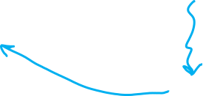
Effect of procedures
foo()
bar()
call bar()
The effect of calling a procedure is the effect of executing its body (parameter passing+return）

Slide 5
Interprocedural Analysis
foo()
bar()
call bar()
goal: compute the abstract effect of calling a procedure

Slide 6
How to do interprocedural analysis?
Can we extend intraprocedural analysis?

Slide 7
Reduction to intraprocedural analysis
Procedure inlining
Naive solution: call-as-goto

Slide 8
Reminder: Constant Propagation
To make the problem precise, we associate one of the following values with X at every program point
The set of values: product of semi-lattices, one component for each variable
Represented by a map m: Var-> V
Value | description
Undef | means that analysis hasn’t determined if control reaches that point
c | constant c
NAC | is definitely not a constant Assigned by an input value Not a constant Assigned different values via paths
Undef
…, -3, -2, -1, 0, 1, 2, 3, …
NAC

Slide 9
Reminder: Constant Propagation
v₁ | v₂ | v₁∧v₂
Undef | Undef | Undef
 | c₂ | c₂
 | NAC | NAC
c₁ | Undef | c₁
 | c₂ | NAC if c₁!=c₂ c₁ otherwise
 | NAC | NAC
NAC | Undef | NAC
 | c₂ | NAC
 | NAC | NAC
Meet: m₁∧m₂ = m₃, such that m₁(x)∧m₂(x) = m₃(x)
i.e., m₁ ≤m₂ iff m₁(x) ≤m₂(x) for all x in Var

Slide 10
Reminder: Constant Propagation
Conservative Solution
Every detected constant is indeed constant
But may fail to identify some constants
Every potential impact is identified
Superfluous impacts

Slide 11
Procedure Inlining
void main() {
int x;
x = p(7);
x = p(9);
}
int p(int a) {
return a + 1;
}

Slide 12
Procedure Inlining
void main() {
int x;
x = p(7);
x = p(9);
}
int p(int a) {
return a + 1;
}
void main() {
int a, x, ret;
a = 7; ret = a+1; x = ret;
a = 9; ret = a+1; x = ret;
}
[a ->Undef, x -> Undef, ret -> Undef]
[a ->7, x ->8, ret ->8]
[a ->9, x ->10, ret ->10]

Slide 13
Procedure Inlining
Pros
Simple
Cons
Does not handle recursion
Exponential blow up
Reanalyzing the body of procedures
p1 {
call p2
…
call p2
}
p2 {
call p3
…
call p3
}
p3{
}

Slide 14
A Naive Interprocedural solution
Treat procedure calls as gotos

Slide 15
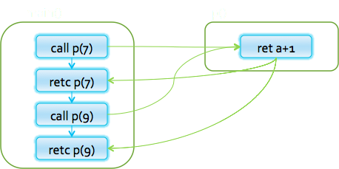
Simple Example
int p(int a) {
return a + 1;
}
void main() {
int x ;
x = p(7);
x = p(9) ;
}

Slide 16
Simple Example
int p(int a) {
[a ->7]
return a + 1;
}
void main() {
int x ;
x = p(7);
x = p(9) ;
}

Slide 17
Simple Example
int p(int a) {
[a->7]
return a + 1;
[a ->7, $$ ->8]
}
void main() {
int x ;
x = p(7);
x = p(9) ;
}

Slide 18
Simple Example
int p(int a) {
[a ->7]
return a + 1;
[a ->7, $$ ->8]
}
void main() {
int x ;
x = p(7);
[x ->8]
x = p(9) ;
[x ->8]
}

Slide 19
Simple Example
int p(int a) {
[a ->7]
return a + 1;
[a ->7, $$ ->8]
}
void main() {
int x ;
x = p(7);
[x ->8]
x = p(9) ;
[x ->8]
}

Slide 20
Simple Example
int p(int a) {
[a ->7] [a ->9]
return a + 1;
[a ->7, $$ ->8]
}
void main() {
int x ;
x = p(7);
[x ->8]
x = p(9) ;
[x ->8]
}

Slide 21
Simple Example
int p(int a) {
[a ->NAC]
return a + 1;
[a ->7, $$ ->8]
}
void main() {
int x ;
x = p(7);
[x ->8]
x = p(9) ;
[x ->8]
}

Slide 22
Simple Example
int p(int a) {
[a ->NAC]
return a + 1;
[a ->NAC, $$ ->NAC]
}
void main() {
int x ;
x = p(7);
[x ->8]
x = p(9);
[x ->8]
}

Slide 23
Simple Example
int p(int a) {
[a ->NAC]
return a + 1;
[a ->NAC, $$ ->NAC]
}
void main() {
int x ;
x = p(7) ;
[x ->NAC]
x = p(9) ;
[x ->NAC]
}

Slide 24
A Naive Interprocedural solution
Treat procedure calls as gotos
Pros:
Simple
Usually fast
Cons:
Abstract call/return correlations
Obtain a conservative solution

Slide 25
Analysis by reduction
Call-as-goto
Procedure inlining
void main() {
int x ;
x = p(7) ;
[x ->NAC]
x = p(9) ;
[x ->NAC]
}
int p(int a) {
[a ->NAC]
return a + 1;
[a ->NAC, $$ ->NAC]
}
void main() {
int a, x, ret;
a = 7; ret = a+1; x = ret;
a = 9; ret = a+1; x = ret;
}
[a ->⊥, x ->⊥, ret ->⊥]
[a ->7, x ->8, ret ->8]
[a ->9, x ->10, ret ->10]
why was the naive solution less precise?

Slide 26
Stack regime
call
P() {
…
R();
…
}
Q() {
…
R();
…
}
R(){
…
}
call
return
return
R
P
Notes:
Regime =组织方法

Slide 27
Review
Meet-Over-Paths (MOP)
MFP
Procedure Inlining
call-as-goto

Slide 28

Guiding light
Exploit stack regime
Precision
Efficiency
Notes:
Main idea / guiding light

Slide 29
Simplifying Assumptions
Parameter passed by value
No procedure nesting
No concurrency
Recursion is supported

Slide 30
Topics Covered
Procedure Inlining
The naive approach
Valid paths
The callstring approach
The Functional Approach
IFDS: Interprocedural Analysis via Graph Reachability
IDE: Beyond graph reachability
The trivial modular approach

Slide 31
Meet-Over-All-Paths (MOP)
Let paths(v) denote the potentially infinite set paths from start to v (written as sequences of edges)
For a sequence of edges [e₁, e₂, …, e_{n}] define f [e₁, e₂, …, e_{n}]: L → L by composing the effects of basic blocks f [e₁, e₂, …, e_{n}](l) = f(e_{n}) (… (f(e₂) (f(e₁) (l)) …)
MOP[v] = Π {f [e₁, e₂, …,e_{n}](l) | [e₁, e₂, …, e_{n}] ∈ paths(v)}
Notes:
Join Over all Paths (JOP)

Slide 32
Meet-Over-All-Paths (MOP)
Paths transformers:
f[e₁,e₂,e₃,e₄]
f[e₁,e₂,e₇,e₈]
f[e₅,e₆,e₇,e₈]
f[e₅,e₆,e₃,e₄]
f[e₁,e₂,e₃,e₄,e₉, e₁,e₂,e₃,e₄]
f[e₁,e₂,e₇,e₈,e₉, e₁,e₂,e₃,e₄,e₉,…]
…
e₁
e₅
e₉
e₂
e₆
e₃
e₇
MOP:
f[e₁,e₂,e₃,e₄](initial) Π
f[e₁,e₂,e₇,e₈](initial) Π
f[e₅,e₆,e₇,e₈](initial) Π
f[e₅,e₆,e₃,e₄](initial) Π …
e₄
e₈
Number of program paths is unbounded due to loops
9

Slide 33
MFP approximates MOP
MOP[v] = Π{f [e₁, e₂, …,e_{n}](l) | [e₁, e₂, …, e_{n}] ∈paths(v)}
MFP[v] = Π {f [e](MFP[v’]) | e =(v’,v)}
MFP ≤ MOP - for a monotone function
f(x Π y) ≤ f(x) Π f(y)
MFP = MOP - for a distributive function
f(x Π y) = f(x) Π f(y)
MFP[v0] = initial
MOP may not be precise enough for interprocedural analysis!

Slide 34
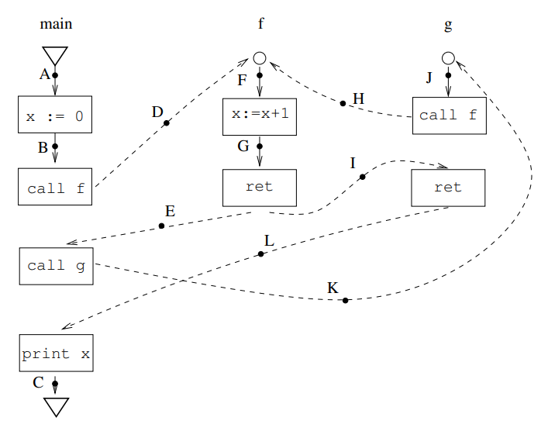
Ex. 1. Actual collecting state at C?
{x → 2}.
Ex. 2. MOP at C using
collecting analysis?
{x → 1, x → 2,
x → 3, . . .}.
MOP is sound but very imprecise.
Reason: Some paths don’t correspond to executions of the program: Eg. ABDFGILC.

Slide 35
Interprocedural analysis
Entry node
Call node
Call node
Return node
Return node
Exit node
Supergraph

Slide 36
Interprocedural analysis
P
Q
R
Entry node
s_{P}
s_{Q}
f_{c2e}
s_{R}
Call node
Call node
f₁
f_{c2e}
f₁
f₁
f₁
n₄
n₆
n₁
n₂
Call Q
Call Q
f₂
f₃
n₅
f₁
n₇
n₃
Return node
Return node
f_{x2r}
f₅
f₃
f_{x2r}
f₆
e_{P}
e_{R}
e_{Q}
Supergraph
Exit node
Notes:
Call edge
Return edge
Call site
Return site

Slide 37
Paths
s
paths(n) the set of paths from s to n
( (s,n₁), (n₁,n₃), (n₃,n₁) )
f₁
f₁
n₁
n₂
f₂
f₃
f₁
n₃
f₃
e

Slide 38
Interprocedural Valid Paths
f₁
f₂
call_{q}
ret
f_{k-1}
f_{k}
f₃
(
)
f_{k-2}
enter_{q}
exit_{q}
f₄
f_{k-3}
f₅
IVP: all paths with matching calls and returns
And prefixes

Slide 39
Interprocedural Valid Paths
IVP set of paths
Start at program entry
Only considers matching calls and returns
aka, valid
Can be defined via context free grammar
matched ::= matched (_{i} matched )_{i} | ε
valid ::= valid (_{i} matched | matched
paths can be defined by a regular expression

Slide 40
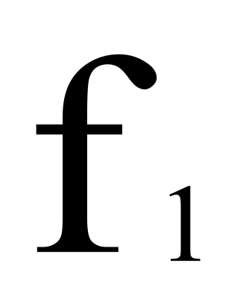
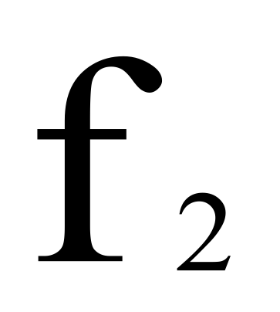
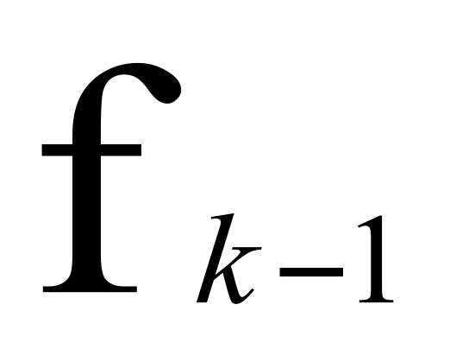
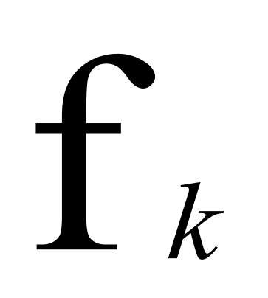
Meet Over All Paths (MOP)
i
start
n
⟦f_{k} o ... o f₁⟧
:L → L
MOP[v] = Π{ [[e₁, e₂, …,e_{n}]](l) | (e₁, …, e_{n}) ∈ paths(v)}
MOP is over-approximated by MFP
Sometimes MOP = MFP
precise up to “symbolic execution”
Distributive problem

Slide 41
The Meet-Over-Valid-Paths (MOVP)
vpaths(n) all valid paths from program start to n
MOVP[n] = Π{ [[e₁, e₂, …, e]] (l) (e₁, e₂, …, e) ∈ vpaths(n)}

Slide 42
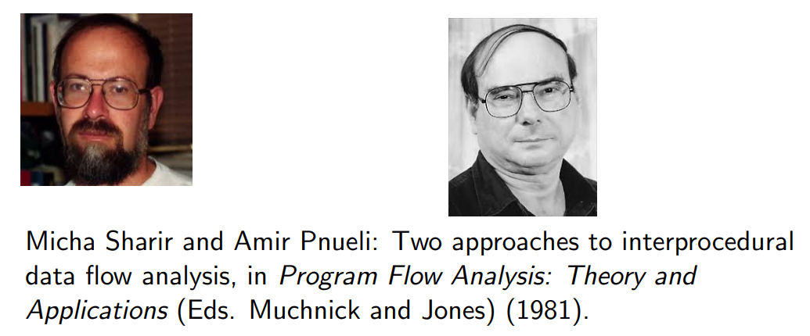
The Call-String Approach
The data flow value is associated with sequences of calls (call string)
Use Chaotic iterations over the supergraph

Slide 43
Interprocedurally valid paths and their call-strings
The call-string of a valid path is a subsequence of call edges which have not been returned as yet.
For example, cs(ABDFGEKJHF) is "KH".

Slide 44
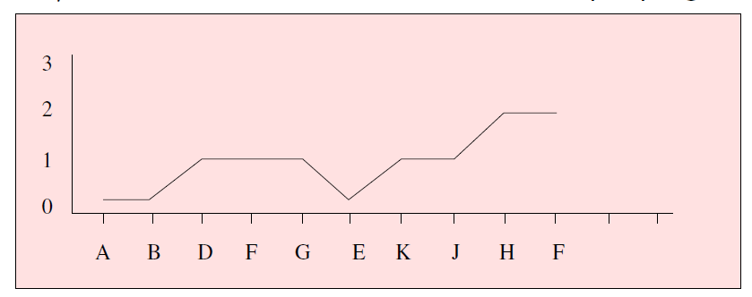
Interprocedurally valid paths and their call-strings
A path = ABDFGEKJHF in IVP for example program:
Associated call-string cs(ABDFGEKJHF) is KH
For path ρ=ABDFGEK, cs(ρ) = K
For path ρ=ABDFGE, cs(ρ) = ε.

Slide 45
Interprocedurally valid paths and their call-strings
More formally: Let ρ be a path in G. We define when ρ is
interprocedurally valid (and we say ρ ∈ IVP(G)) and its call-string cs(ρ), by induction on the length of ρ.
If ρ = ε then ρ ∈ IVP(G). In this case cs(ρ) = ε.
If ρ = ρ’ n then ρ ∈ IVP(G) iff ρ’∈ IVP(G), and one of the following holds:
n is neither a call nor a ret edge. In this case cs(ρ) = cs(ρ’)
n is a call edge. In this case cs(ρ) = cs(ρ’) n.
n is ret edge. Suppose cs(ρ’) = π C, and n corresponds to the call edge C. In this case, cs(ρ) = π
The set of (potential) call-strings in G is C*, where C is the set of call edges in G

Slide 46
Simple Example
int p(int a) {
return a + 1;
}
void main() {
int x ;
c1: x = p(7);
c2: x = p(9) ;
}

Slide 47
Simple Example
int p(int a) {
c1: [a ->7]
return a + 1;
}
void main() {
int x ;
c1: x = p(7);
c2: x = p(9) ;
}

Slide 48
Simple Example
int p(int a) {
c1: [a ->7]
return a + 1;
c1:[a ->7, $$ ->8]
}
void main() {
int x ;
c1: x = p(7);
c2: x = p(9) ;
}

Slide 49
Simple Example
int p(int a) {
c1: [a ->7]
return a + 1;
c1:[a ->7, $$ ->8]
}
void main() {
int x ;
c1: x = p(7);
ε: x -> 8
c2: x = p(9) ;
}

Slide 50
Simple Example
int p(int a) {
c1:[a ->7]
return a + 1;
c1:[a ->7, $$ ->8]
}
void main() {
int x ;
c1: x = p(7);
ε: [x -> 8]
c2: x = p(9) ;
}

Slide 51
Simple Example
int p(int a) {
c1:[a ->7] c2:[a ->9]
return a + 1;
c1:[a ->7, $$ ->8]
}
void main() {
int x ;
c1: x = p(7);
ε : [x -> 8]
c2: x = p(9) ;
}

Slide 52
Simple Example
int p(int a) {
c1:[a ->7] c2:[a ->9]
return a + 1;
c1:[a ->7, $$ ->8] c2:[a ->9, $$ ->10]
}
void main() {
int x ;
c1: x = p(7);
ε : [x -> 8]
c2: x = p(9) ;
}

Slide 53
Simple Example
int p(int a) {
c1:[a ->7] c2:[a ->9]
return a + 1;
c1:[a ->7, $$ ->8] c2:[a ->9, $$ ->10]
}
void main() {
int x ;
c1: x = p(7);
ε : [x -> 8]
c2: x = p(9) ;
ε : [x -> 10]
}

Slide 54
The Call-String Approach
The data flow value is associated with sequences of calls (call string)
Use Chaotic iterations over the supergraph, (MFP)
To guarantee termination limit the size of call string (typically 1 or 2)
Represents tails of calls
Abstract inline

Slide 55
Another Example (|cs|=2)
void main() {
int x ;
c1: x = p(7);
ε : [x -> 16]
c2: x = p(9) ;
ε : [x -> 20]
}
int p(int a) {
c1:[a ->7] c2:[a ->9]
return c3: p1(a + 1);
c1:[a ->7, $$ ->16] c2:[a ->9, $$ ->20]
}
int p1(int b) {
c1.c3:[b ->8]
c2.c3:[b ->10]
return 2 * b;
c1.c3:[b ->8,$$ -> 16]
c2.c3:[b ->10,$$ -> 20]
}

Slide 56
Another Example (|cs|=1)
void main() {
int x ;
c1: x = p(7);
ε : [x -> NAC]
c2: x = p(9) ;
ε: [x -> NAC]
}
int p(int a) {
c1:[a ->7] c2:[a ->9]
return c3: p1(a + 1);
c1:[a ->7, $$ -> NAC] c2:[a ->9, $$ -> NAC]
}
int p1(int b) {
(c1|c2)c3:[b ->NAC]
return 2 * b;
(c1|c2)c3:[b -> NAC,
$$-> NAC]
}

Slide 57
Handling Recursion
void main() {
c1: p(7);
ε : [x -> NAC]
}
int p(int a) {
c1: [a -> 7] c1.c2+: [a -> NAC]
if (…) {
c1: [a -> 7] c1.c2+: [a -> NAC]
a = a -1 ;
c1: [a -> 6] c1.c2+: [a -> NAC]
c2: p (a);
c1.c2*: [a -> NAC]
a = a + 1;
c1.c2*: [a -> NAC]
}
c1.c2*: [a -> NAC]
x = -2*a + 5;
c1.c2*: [a -> NAC, x-> NAC]
}

Slide 58
Summary Call-String
Easy to implement
Efficient for very small call strings
Limited precision
Often loses precision for recursive programs
For finite domains can be precise even with recursion (with a bounded callstring)
Order of calls can be abstracted
Related method: procedure cloning

Slide 59
The Functional Approach
The meaning of a procedure is mapping from states into states
The abstract meaning of a procedure is function from an abstract state to abstract states
Relation between input and output
In certain cases can compute MOVP

Slide 60
The Functional Approach
Two phase algorithm
Compute the dataflow solution at the exit of a procedure as a function of the initial values at the procedure entry (functional values)
Compute the dataflow values at every point using the functional values

Slide 61
Phase 1
void main() {
p(7);
}
int p(int a) {
if (…) {
a = a -1 ;
p (a);
a = a + 1;
}
x = -2*a + 5;
}
[a ->a₀, x ->x₀]
[a ->a₀, x ->x₀]
[a ->a₀-1, x ->x₀]
[a ->a₀-1, x ->-2a₀+7]
[a ->a₀, x ->-2a₀+7]
[a ->a₀, x ->x₀]
[a ->a₀, x ->NAC]
p(a₀,x₀) = [a ->a₀, x ->-2a₀ + 5]
[a ->a₀, x -> -2*a₀+5]

Slide 62
Phase 2
void main() {
p(7);
}
int p(int a) {
if (…) {
a = a -1 ;
p (a);
a = a + 1;
}
x = -2*a + 5;
}
[a ->7, x ->0]
[a ->NAC, x ->0]
[x -> -9]
[a ->7, x ->0]
[a -> NAC, x ->0]
[a ->6, x ->0]
[a -> NAC, x ->0]
[a ->6, x ->-7]
[a -> NAC, x -> NAC]
[a ->7, x ->-7]
[a -> NAC, x -> NAC]
p(a₀,x₀) = [a ->a₀, x ->-2a₀ + 5]
[a ->7, x ->0]
[a -> NAC, x -> NAC]
[a ->7, x ->-9]
[a -> NAC, x -> NAC]

Slide 63
Issues in Functional Approach
How to guarantee that finite height for functional lattice?
It may happen that L has finite height and yet the lattice of monotonic function from L to L do not
Efficiently represent functions
Functional meet
Functional composition
Testing equality

Slide 64
Summary Functional approach
Computes procedure abstraction
Sharing between different contexts
Rather precise
Recursive procedures may be more precise/efficient than loops
But requires more from the implementation
Representing (input/output) relations
Composing relations

Slide 65
Review
Meet-Over-All-Paths (MOP)
MFP
The Meet-Over-Valid-Paths (MOVP)
Procedure Inlining
call-as-goto
The Call-String Approach
The Functional Approach

Slide 66
CFL-Graph reachability [RHS’95]
Static analysis of programs with proecedures
Special cases of functional analysis
Reduce the interprocedural analysis problem to finding context free reachability
[RHS’95] Thomas W. Reps, Susan Horwitz, Shmuel Sagiv: Precise Interprocedural Dataflow Analysis via Graph Reachability. POPL 1995

Slide 67
The Context-Free Reachability Problem
A finite directed graph G(s, V, E)
A finite alphabet Σ
A labeling function l: E → Σ
A context-free grammar C over Σ
A property holds at n ∈ N if there exists a path from s to n whose labels are in C
Notes:
Driver Verifier SLAM

Slide 68
IFDS Problems
IFDS= interprocedural, finite, distributive, subset
Finite subset distributive
Lattice L = PowerSet(D), D=Data facts
Transfer functions L->L are distributive
Efficient solution through formulation as CFL reachability
Can be generalized to certain infinite lattices

Slide 69
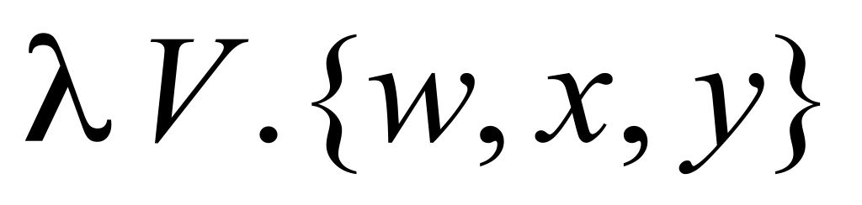
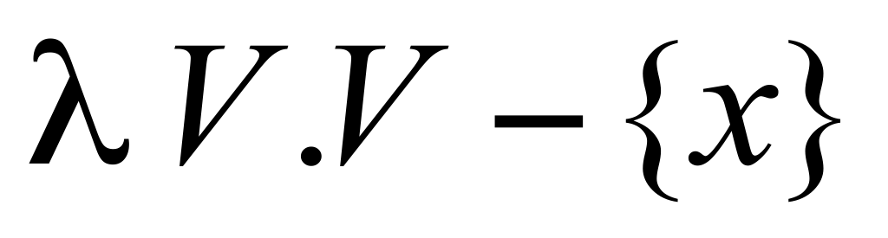
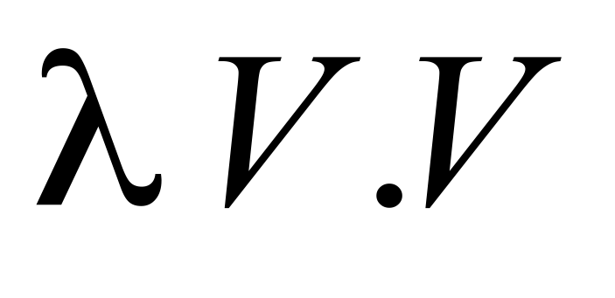
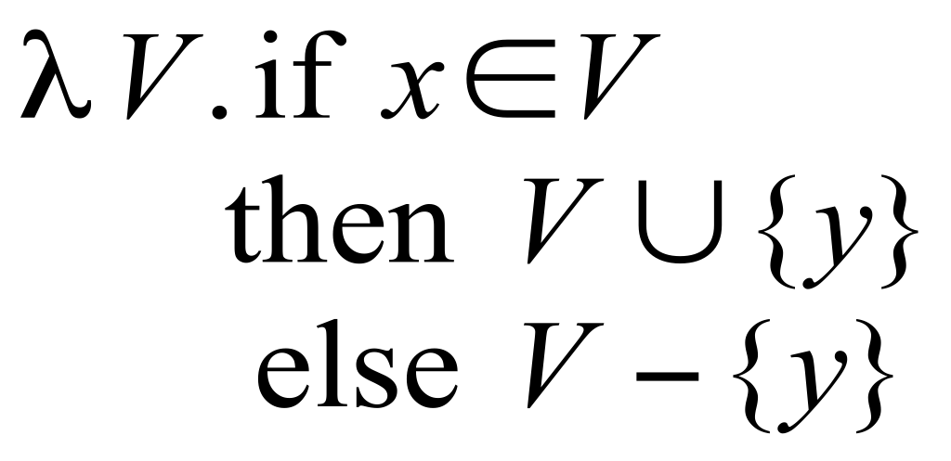
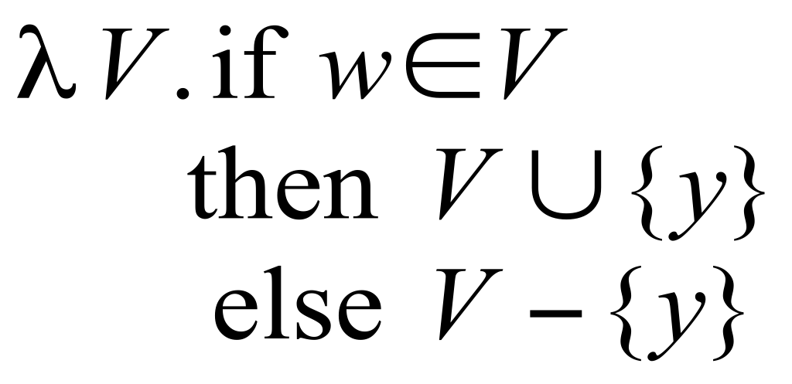
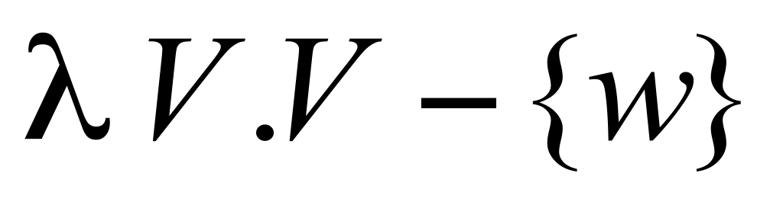
Possibly Uninitialized Variables
{}
Start
{w,x,y}
x = 3
{w,y}
if . . .
{w,y}
y = x
{w,y}
{w}
y = w
w = 8
{}
{w,y}
printf(y)
{w,y}

Slide 70
Efficiently Representing Functions
Let f: 2^{D}→2^{D} be a distributive function,
i.e., f(x Π y)=f(x) Πf(y)
Then:
f(X) = f(∅) Π { f({z}) | z ∈ X }

Slide 71
Encoding Transfer Functions
Enumerate all input space and output space
Represent functions as graphs with 2(D+1) nodes
Special symbol “0” denotes empty sets (sometimes denoted ☹)
Example: D = { a, b, c } f(S) = (S – {a}) U {b}
0
a
b
c
0
a
b
c

Slide 72

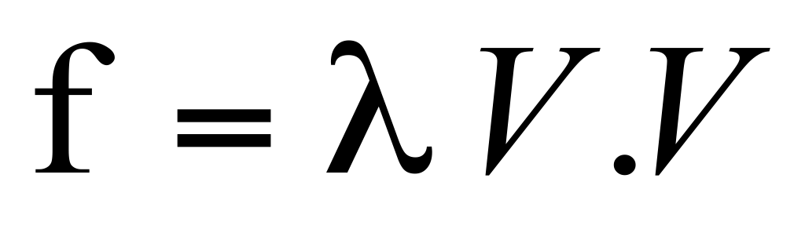
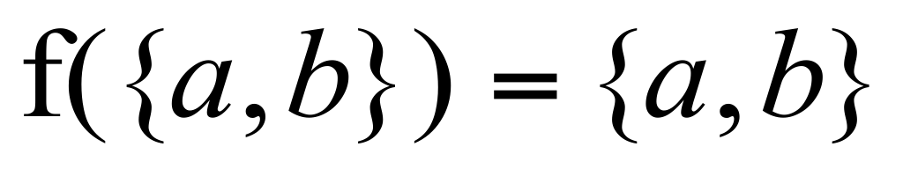
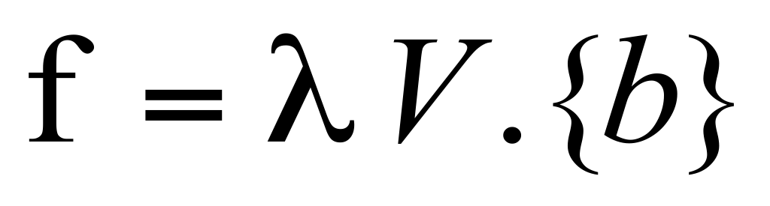
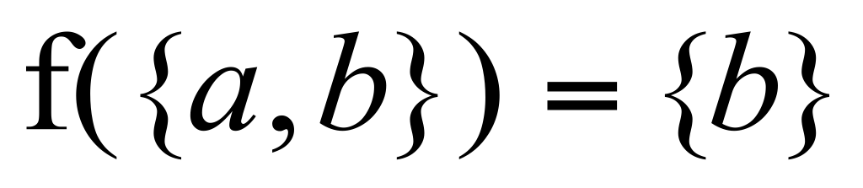
Representing Dataflow Functions
a
b
c
Identity Function
a
b
c
Constant Function

Slide 73
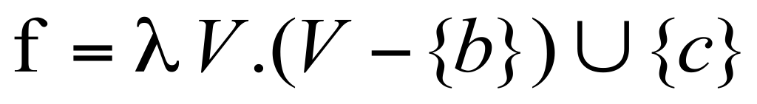
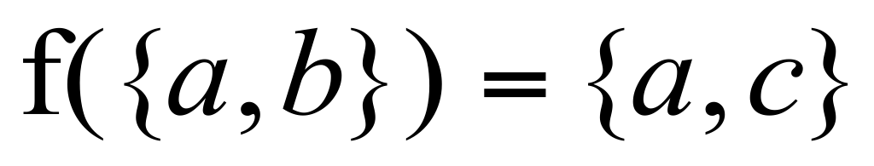
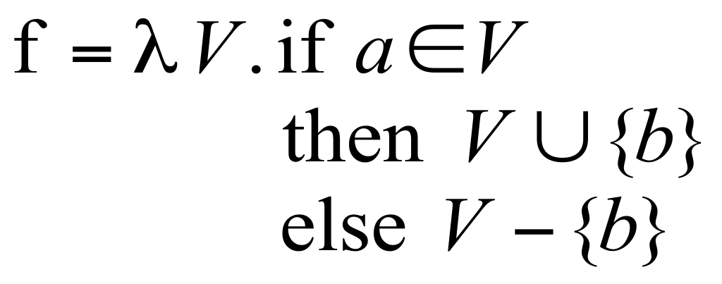
Representing Dataflow Functions
a
b
c
“Gen/Kill” Function
Non-“Gen/Kill” Function
a
b
c

Slide 74
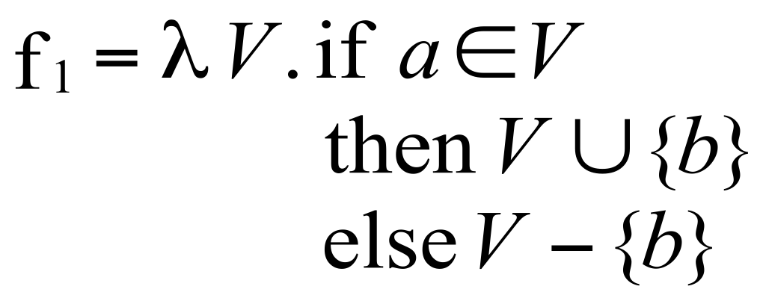
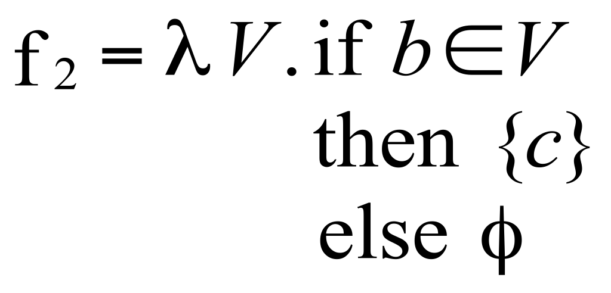
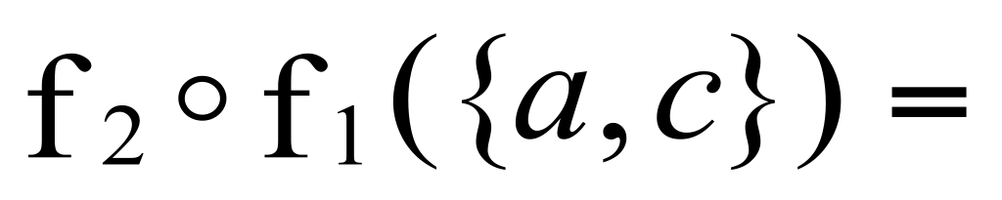

Composing Dataflow Functions
a
a
b
b
c
c
a
b
c

Slide 75
x
y
start p(a,b)
a
b
start main
if . . .
x = 3
b = a
p(x,y)
p(a,b)
return from p
return from p
printf(y)
printf(b)
exit main
exit p

Slide 76
(
x
y
(
start p(a,b)
a
b
start main
if . . .
x = 3
Might b be
uninitialized
here?
Might y be
uninitialized
here?
b = a
p(x,y)
p(a,b)
return from p
return from p
printf(y)
printf(b)
NO!
YES!
exit main
)
exit p
]

Slide 77
The Tabulation Algorithm
Worklist algorithm, start from entry of “main”
Keep track of
Path edges: matched paren paths from procedure entry
Summary edges: matched paren call-return paths
At each instruction
Propagate facts using transfer functions; extend path edges
At each call
Propagate to procedure entry, start with an empty path
If a summary for that entry exits, use it
At each exit
Store paths from corresponding call points as summary paths
When a new summary is added, propagate to the return node

Slide 78
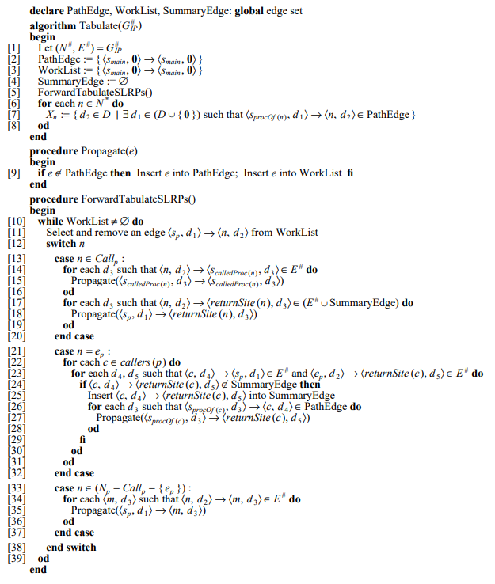

Slide 79
Asymptotic Running Time
CFL-reachability
Exploded control-flow graph: ND nodes
Running time: O(N³D³)
Exploded control-flow graph Special structure
Running time: O(ED³)
Typically: E ≈ N, hence O(ED³) ≈ O(ND³)
“Gen/kill” problems: O(ED)

Slide 80

Some Applications
Mayur Naik: Jchord a static analysis for Java
IBM Watson: Wala static analysis tool
Thomas Ball, Vladimir Levin, Sriram K. Rajaman
A decade of software model checking with SLAM.CACM’11
Manu Sridharan, Rastislav Bodík: Refinement-based context-sensitive points-to analysis for Java. PLDI 2006
Nomair A. Naeem, Ondrej Lhoták, Jonathan Rodriguez: Practical Extensions to the IFDS Algorithm. CC 2010: 124-144
Osbert Bastani, Saswat Anand, Alex Aiken: Specification Inference Using Context-Free Language Reachability, POPL’15
K Chatterjee, A Pavlogiannis, Y Velner: Quantitative interprocedural analysis, POPL’15
S Yang, D Yan, H Wu, Y Wang: Static control-flow analysis of user-driven callbacks in Android applications
Notes:
1142

Slide 81
IDE
IDE=Interprocedural Distributive Environment
Goes beyond IFDS problems
Can handle unbounded domains
Env: finite symbols->infinite domain
Requires special form of the domain
Can be much more efficient than IFDS
Precise interprocedural dataflow analysis with applications to constant propagation. Mooly Sagiv, Thomas Reps, Susan Horwitz.
Theoretical Computer Science, 1996

Slide 82
IDE Analysis
Point-wise representation closed under composition
CFL-Reachability on the exploded graph
Two phase algorithm
Compose functions
Compute dataflow values

Slide 83
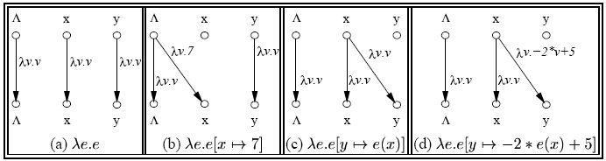
Linear constant propagation
Point-wise representation of environment transformers

Slide 86
Conclusion
Handling functions is crucial for abstract interpretation
Virtual functions and exceptions complicate things
But scalability is an issue
Small call strings
Small functional domains
Demand analysis

Slide 87
Bibliography
Textbook 2.5
Patrick Cousot & Radhia Cousot. Static determination of dynamic properties of recursive procedures In IFIP Conference on Formal Description of Programming Concepts, 1978
Two Approaches to interprocedural analysis by Micha Sharir and Amir Pnueli: 1
IDFS Interprocedural Distributive Finite Subset Precise interprocedural dataflow analysis via graph reachability. Reps, Horowitz, and Sagiv, POPL’95
IDE Interprocedural Distributive Environment Precise interprocedural dataflow analysis with applications to constant propagation. Sagiv, Reps, Horowitz, and TCS’96

